Slide 1
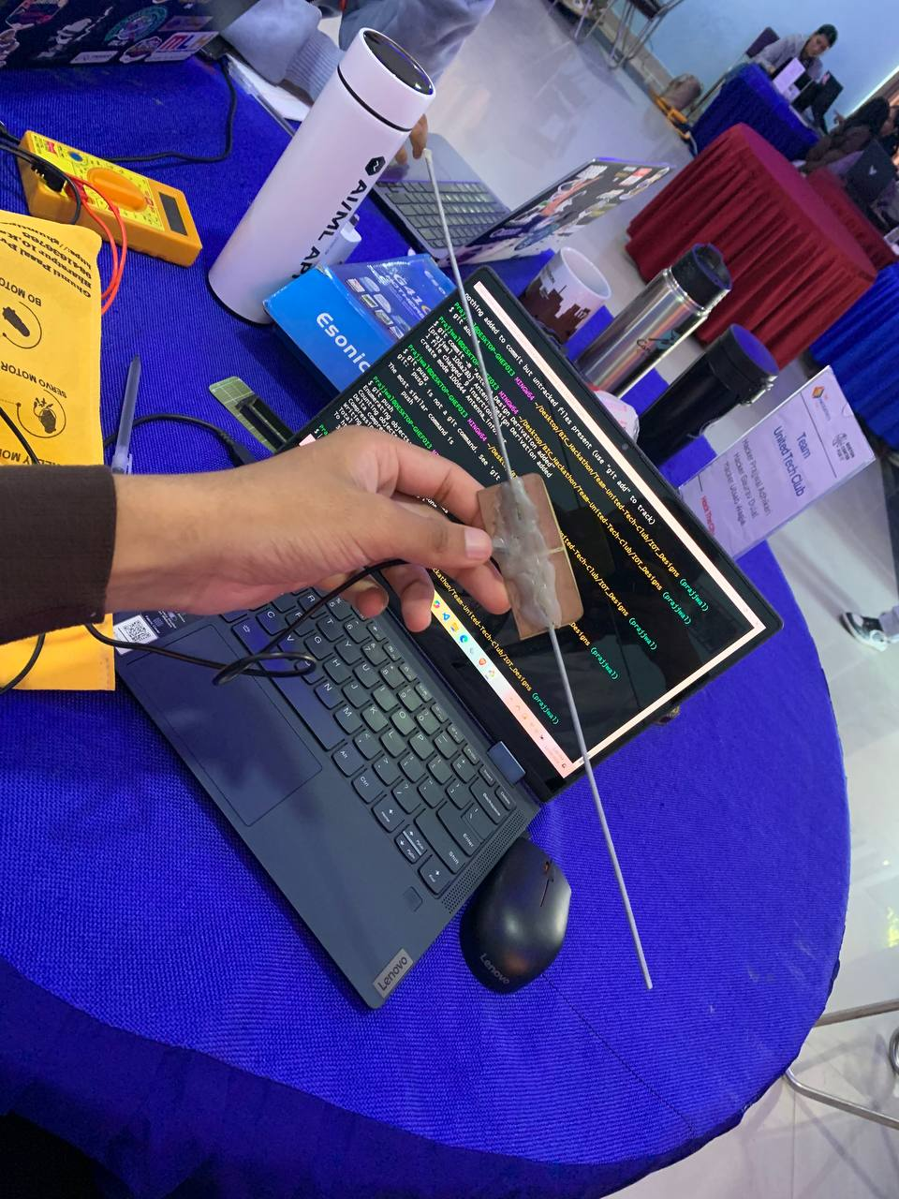


LORA
BASED PROJECT
-United Tech Club

Slide 2
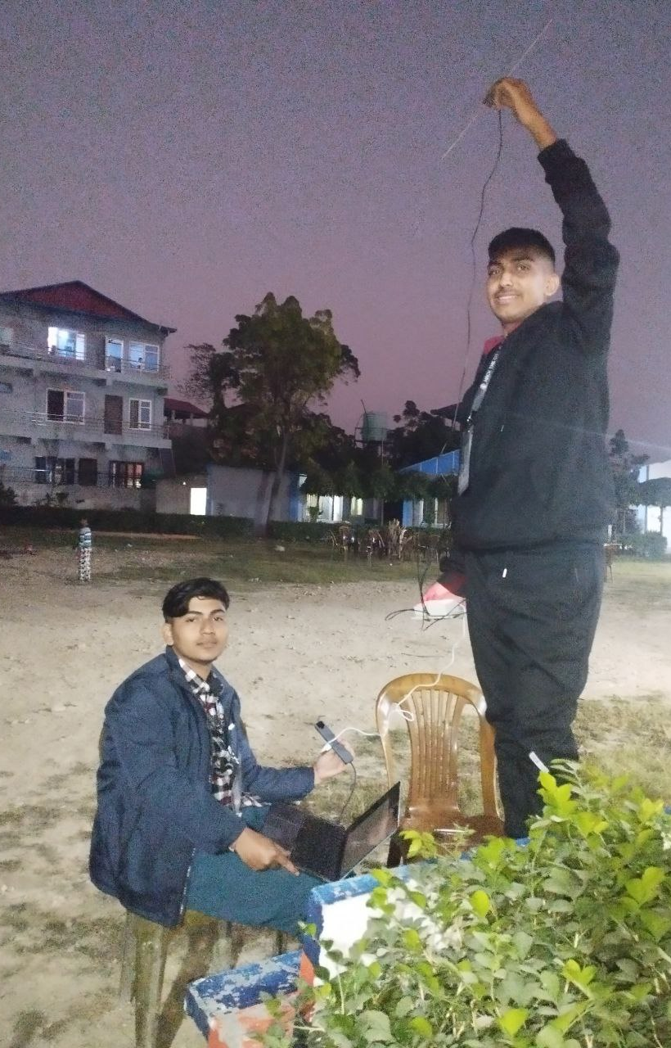

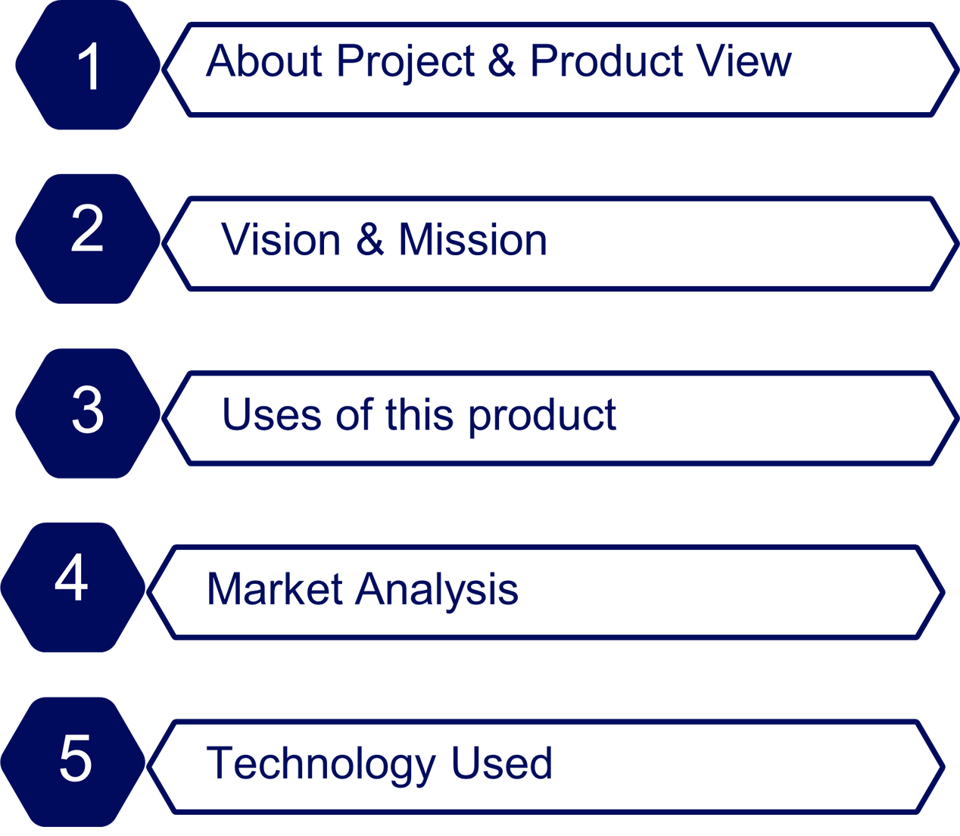

Slide 3

INTRODUCTION
Efficient and Reliable Tracking
Designed for diverse applications.
Can be used from anywhere
Overcomes limitations of cellular & satellite tracking technologies.
Specalized for animal tracking

Slide 4
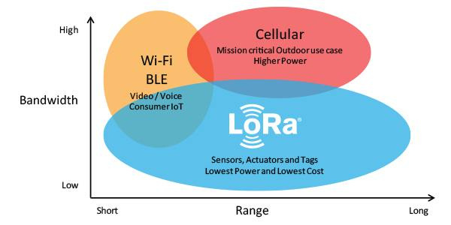
WHAT IS LORA..?

Slide 5
VISION OF DEVELOPMENT
1
2
3
4
SUITABILITY FOR REMOTE AND CHALLENGING ENVIRONMENTS.
ROBUST, COST-EFFECTIVE, AND SCALABLE TRACKING SOLUTION.
ENHANCE OPERATIONAL EFFICIENCY AND REAL-TIME DATA ACCESS
SURPASS LIMITATIONS OF CELLULAR AND SATELLITE TRACKING TECHNOLOGIES.

Slide 6
USE SECTOR OF NAVIKAM
1
2
3
4
ASSEST TRACKING
WILDLIFE TRACKING
RESCUE OPERATION
PERSONAL SECURITY

Slide 7

REAL-TIME TRACKING OF ANIMALS.
TRACKS AND MANAGES VALUABLE ASSETS
ENHANCES PERSONAL AND ASSET SECURITY.
FACILITATES LOCATION AND RESCUE IN DISASTER-STRICKEN AREAS
USEFUL WHERE CONVENTIONAL COMMUNICATION SYSTEMS FAIL.

Slide 8
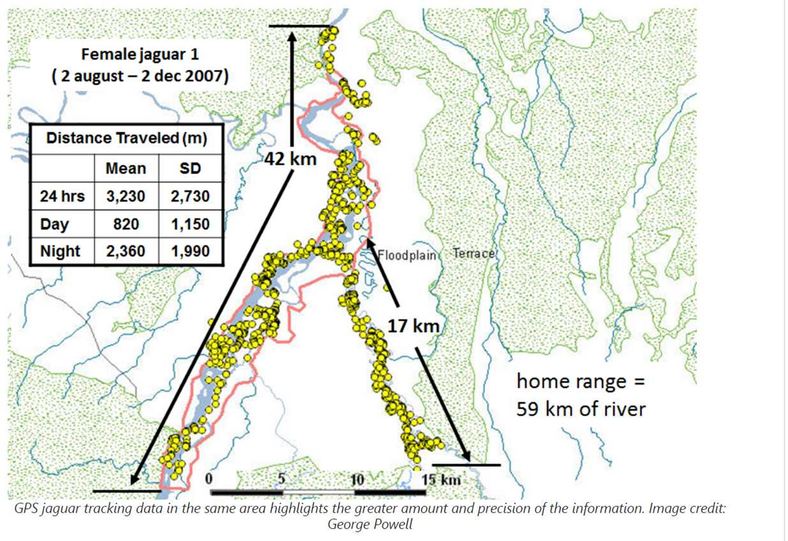
ONE USE EXAMPLE

Slide 9


MARKET ANALYSIS

Slide 10
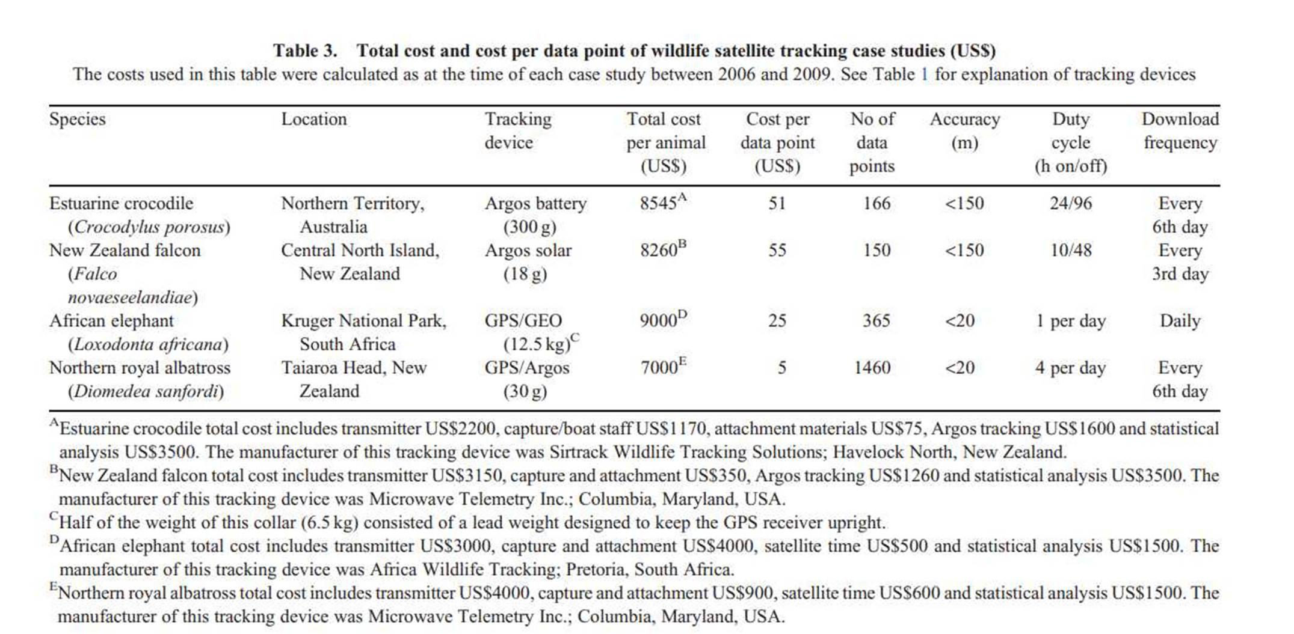


Slide 11
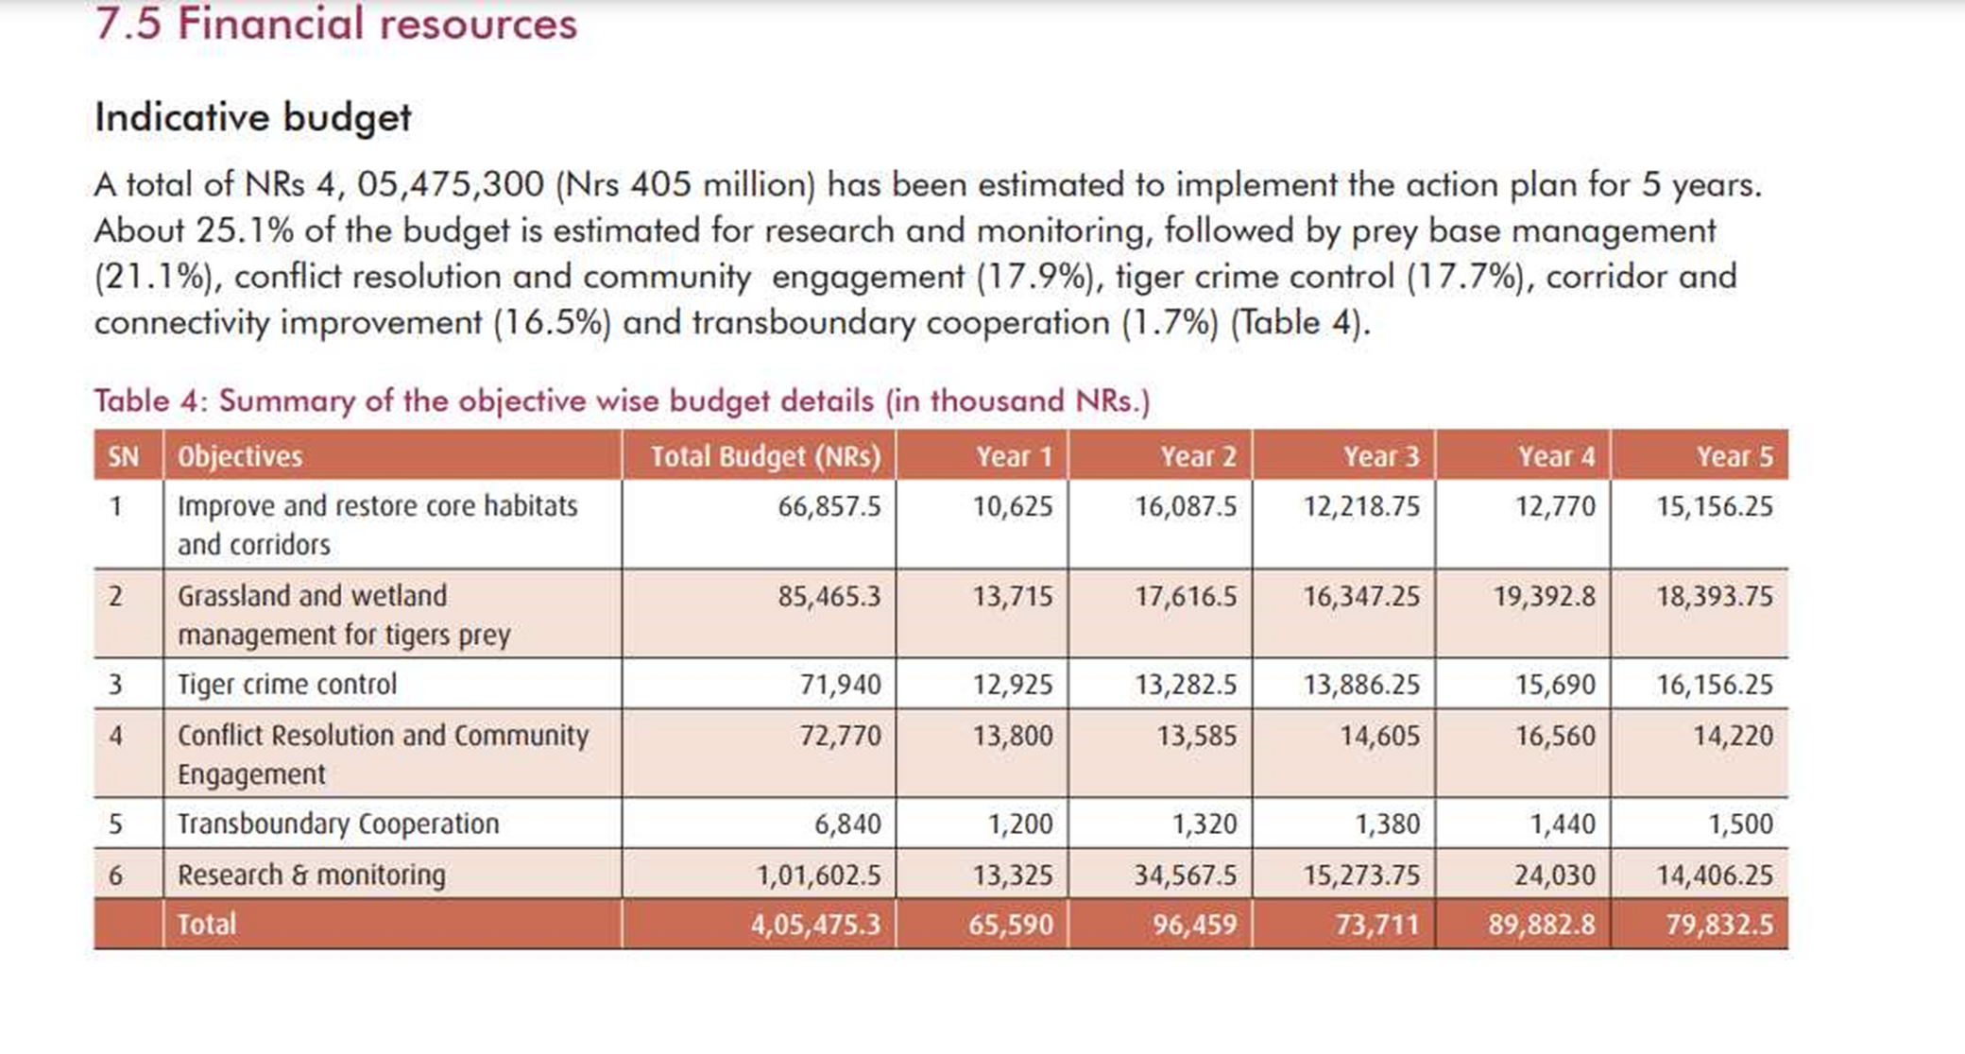

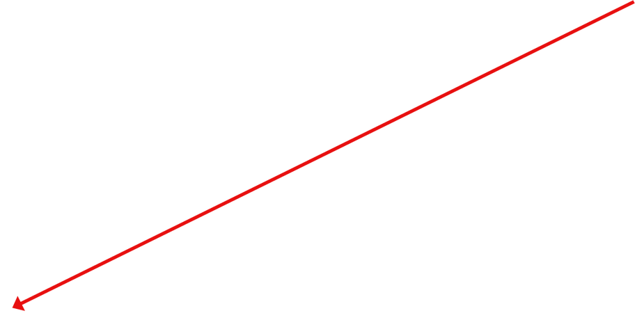

4 ARAB

Slide 12
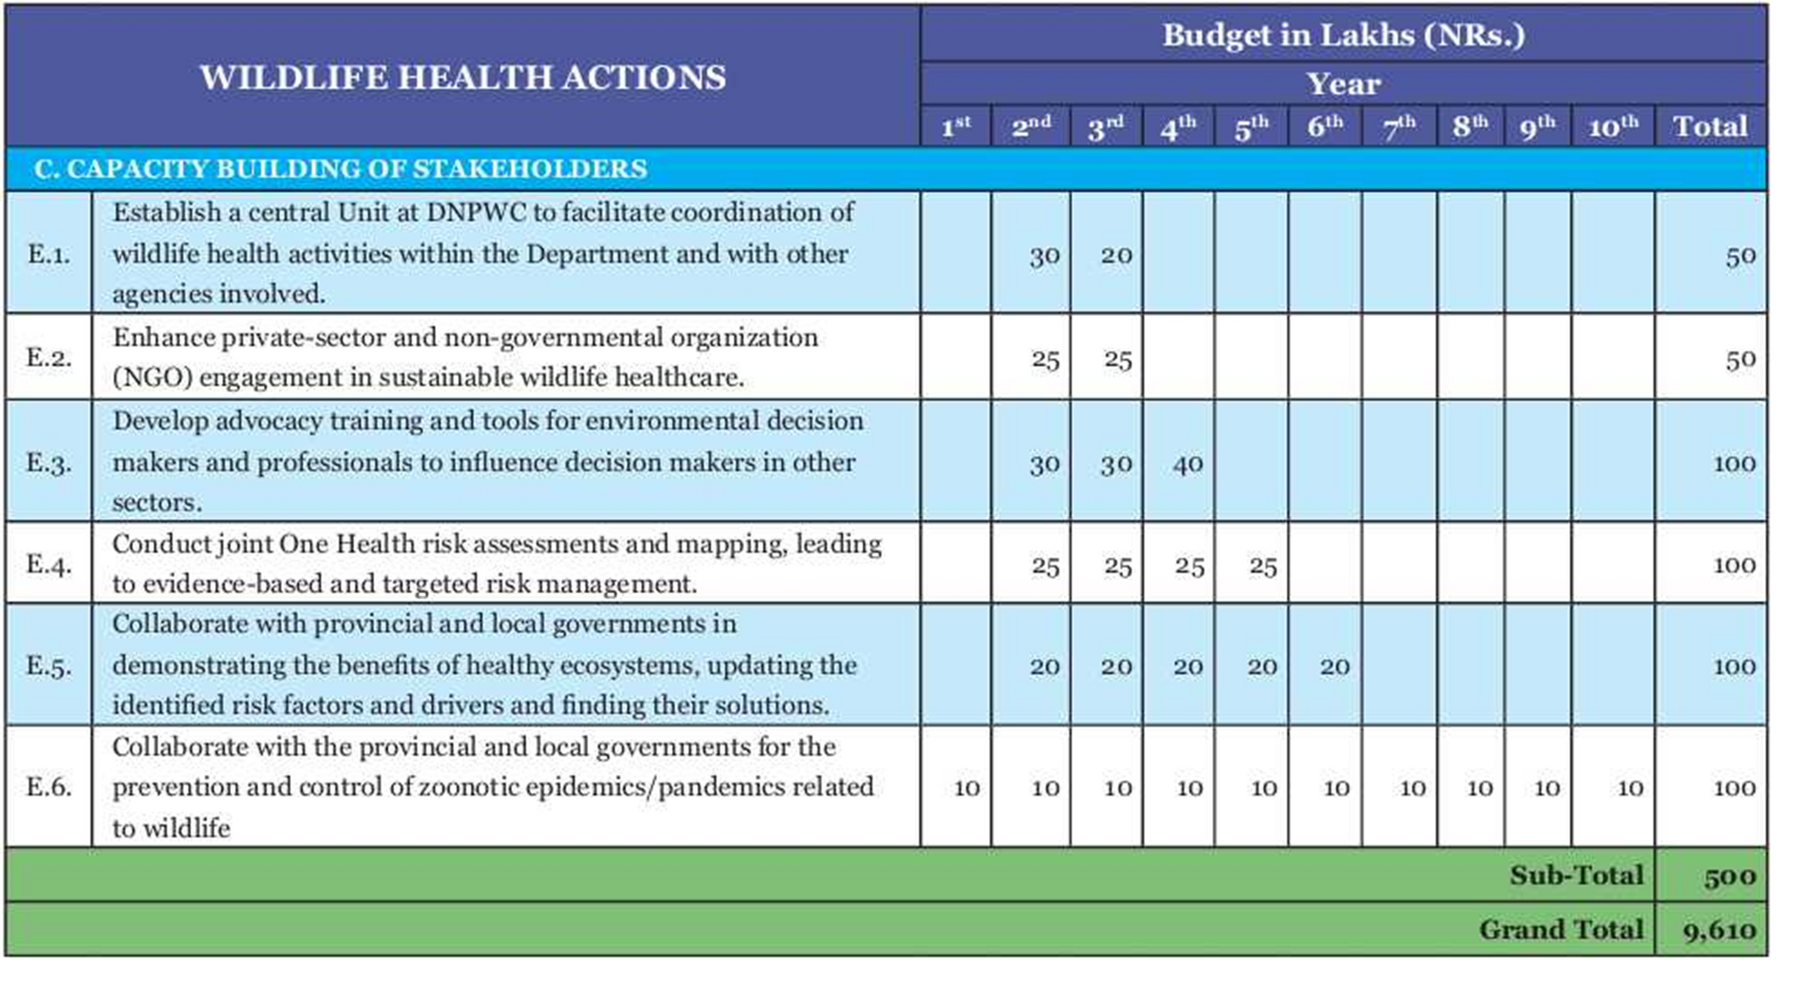

Wild-Life Act 2023-2034

Slide 13
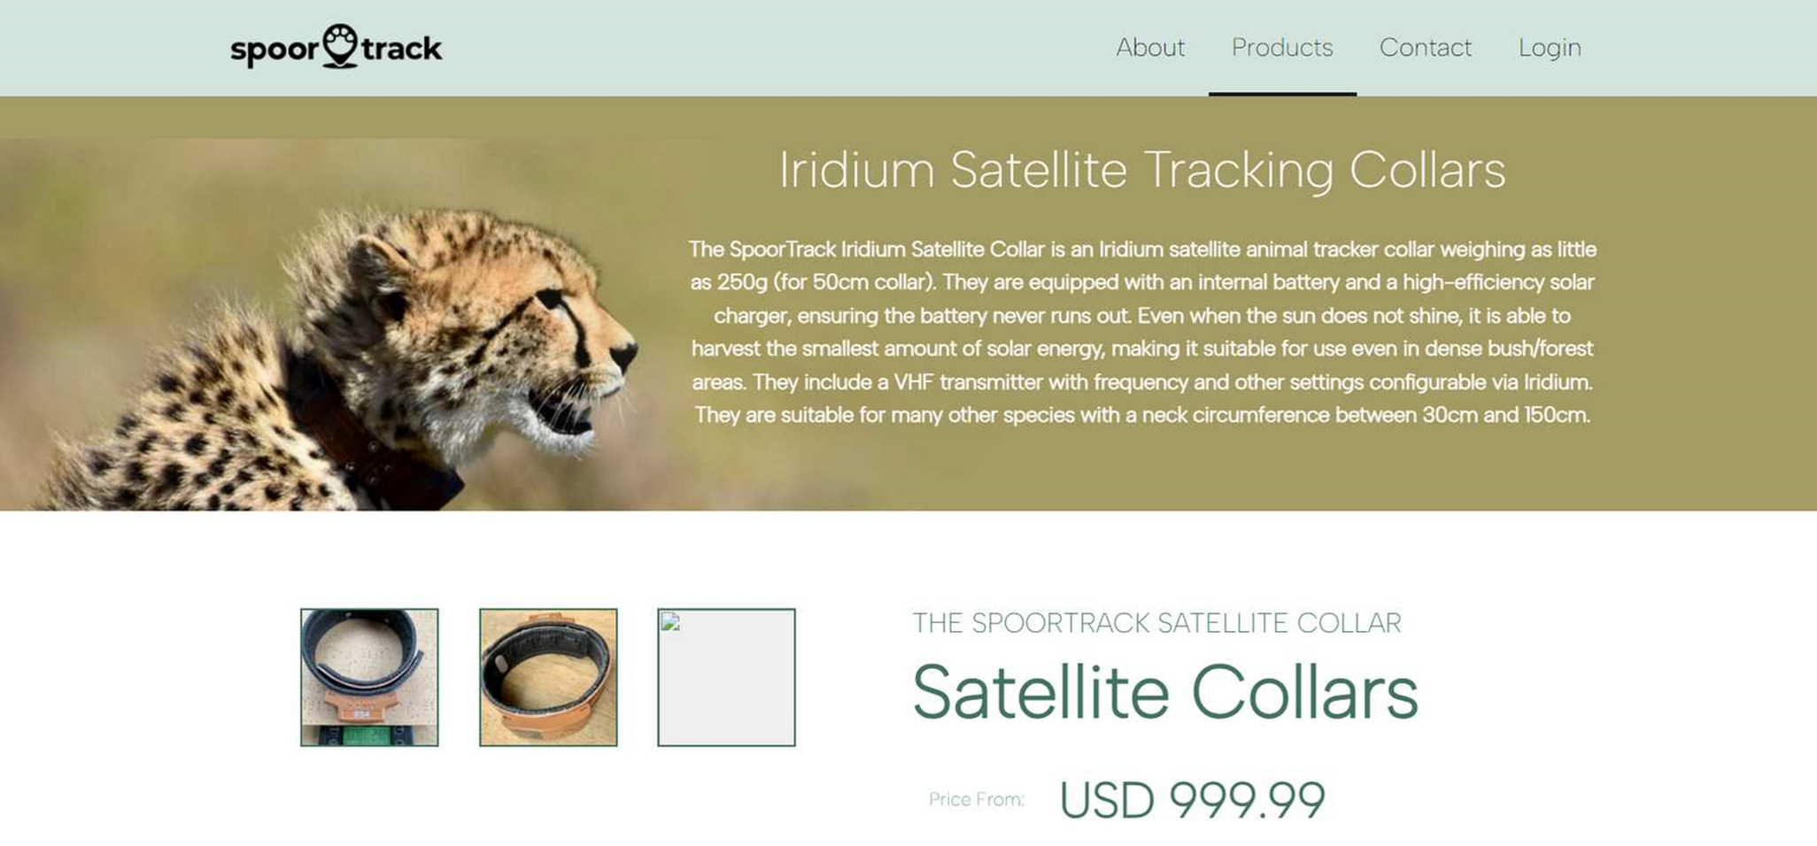


Slide 14

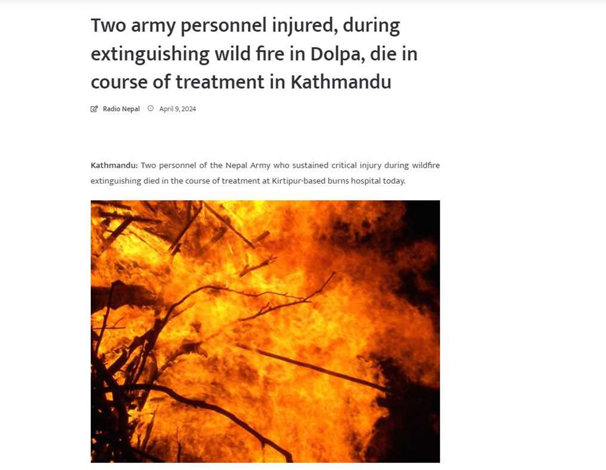

Slide 15
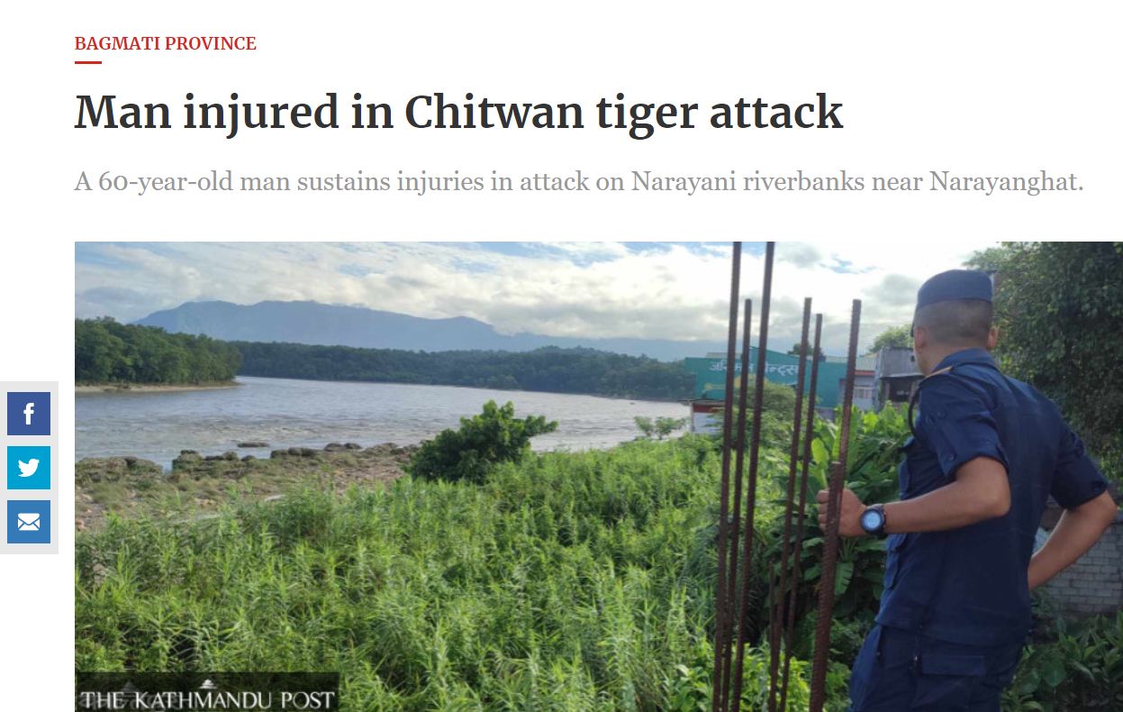


Slide 16
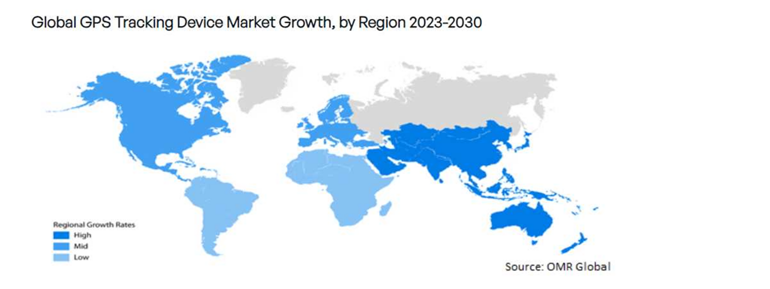
LORA MARKET

Slide 17
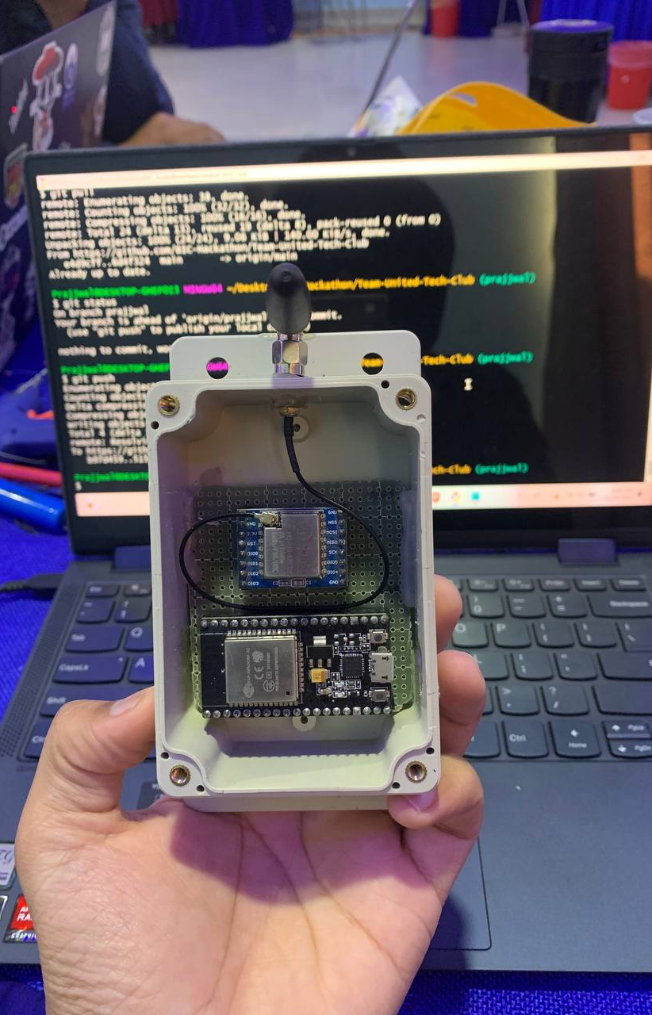
ALERT!
OUR PROJECT CAN BE MADE UNDER 15k-20K
MARKET OPPORTUNITY

Slide 18


HARDWARE CONFIGURATION
DEFINE
ANALYZE
IMPROVE
CONTROL

Slide 19
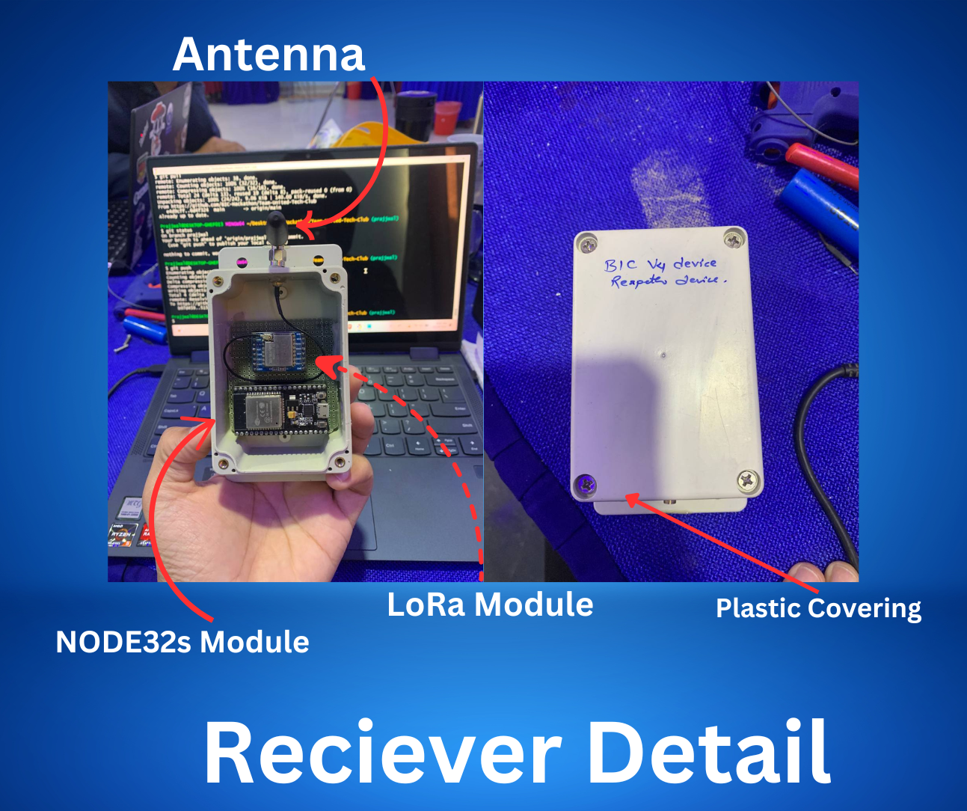

Slide 20
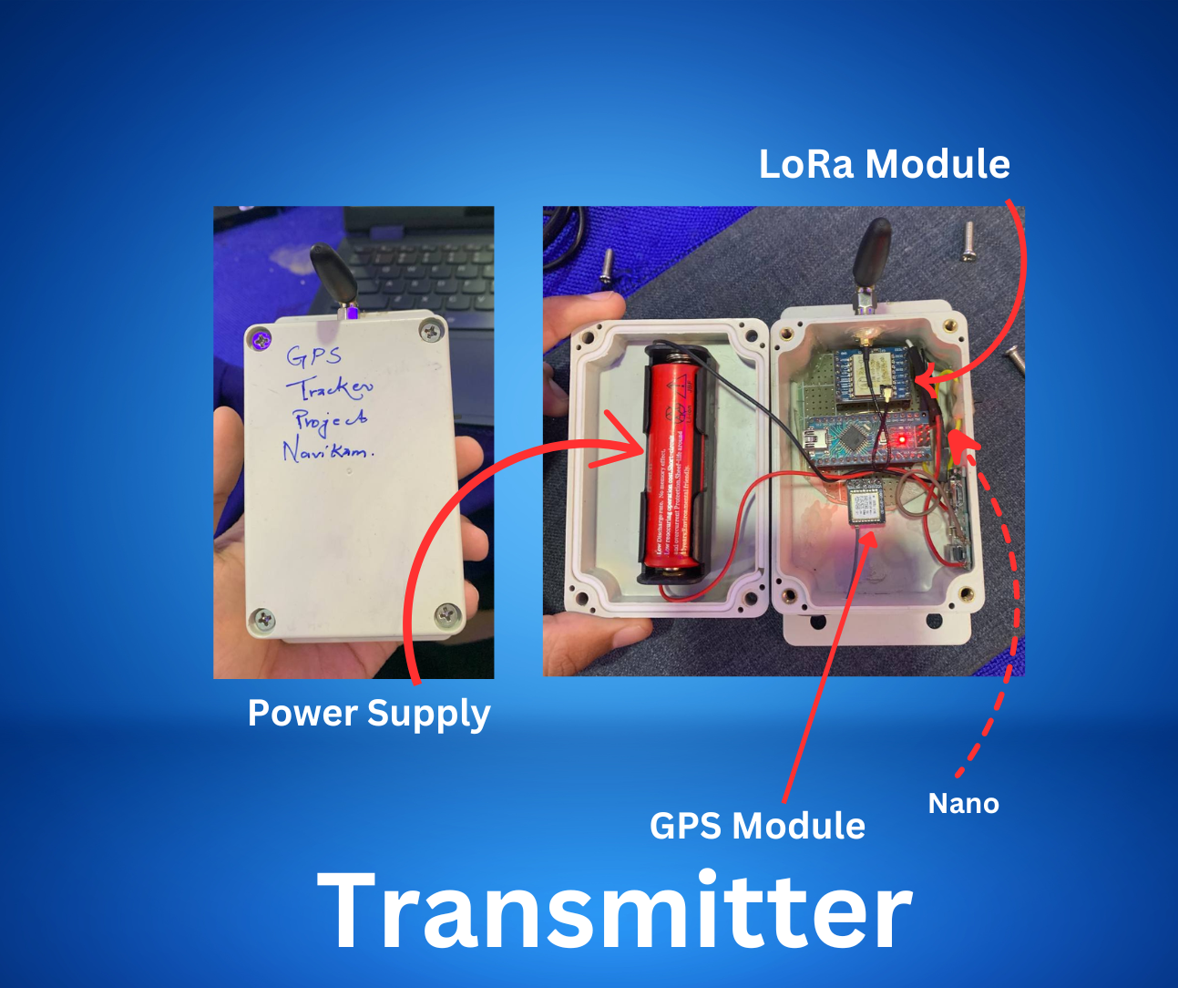
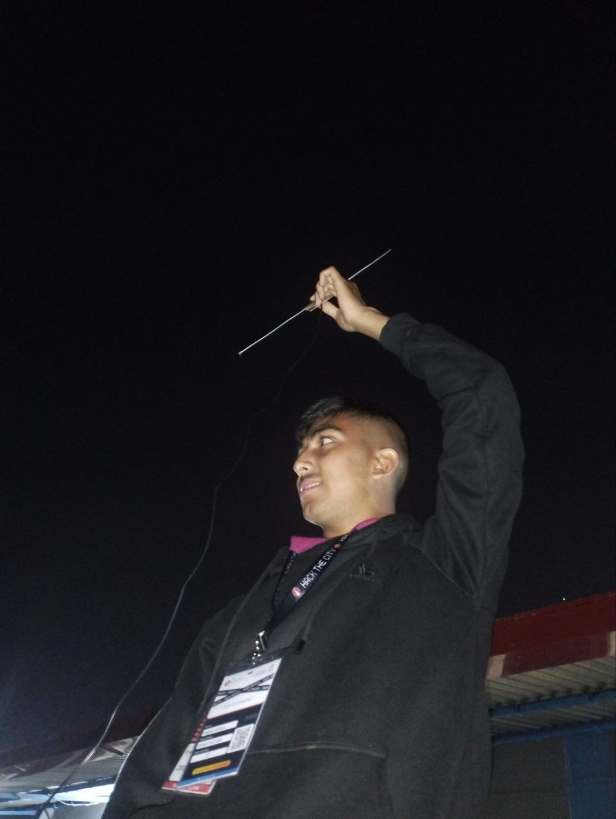


Slide 21
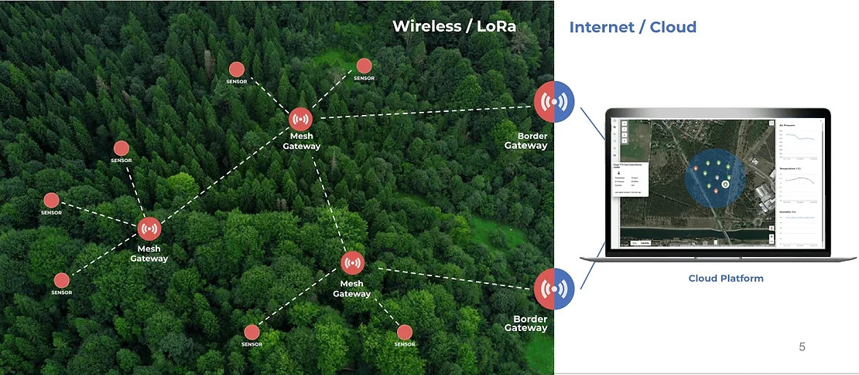
MESH PLAN OF

Slide 22
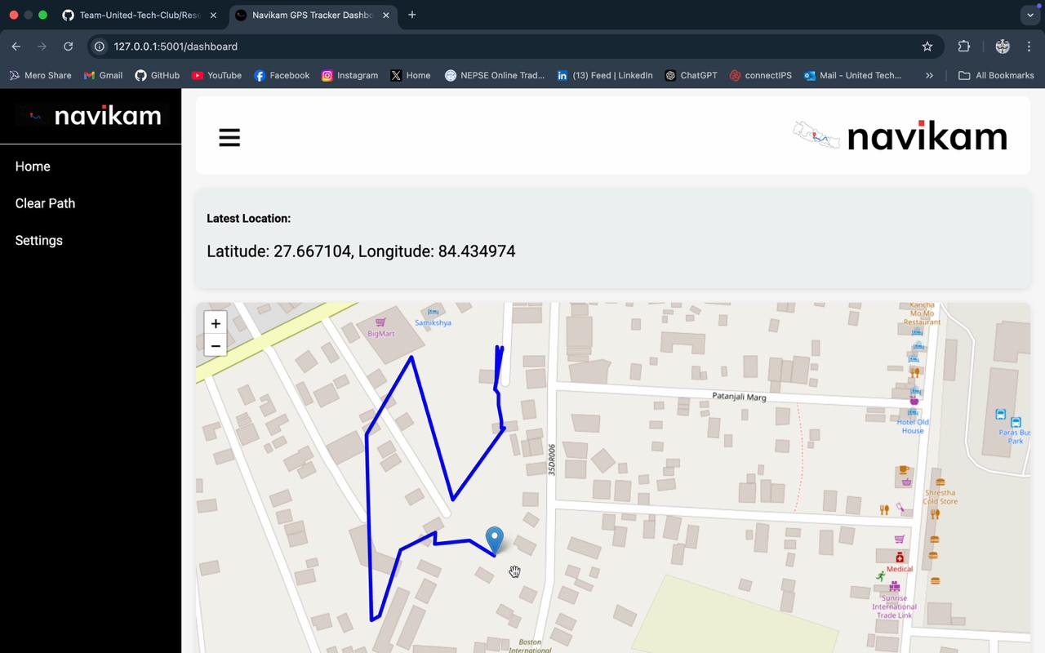

Slide 23
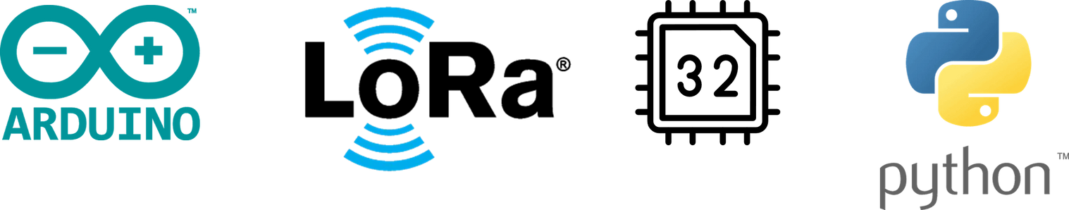



TECHNOLOGIES USED

Slide 24


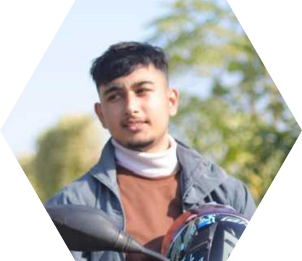
MEET OUR TEAM
UTSAV
WAGLE
PRAJJWAL
ADHIKARI
IOT, Research
Frontend Dev.
GAURAV
DULAL
Backend Developer

